Slide 1
Discussion Unit: DSE Analytics
Define Machine Learning (ML)
Overview MLlib/ML libraries
ML process, design pattern/flow
Upsell, customers who bought (x) bought (y)
Predict customer churn
Machine Learning
Notes:
The goal of this Discussion Unit is to:
Define Machine Learning (ML)
Overview MLlib/ML libraries
ML process, design pattern/flow
Upsell, customers who bought (x) bought (y)
Predict customer churn

Slide 2
Discussion Lab:
DSE Analytics; Business Intelligence (BI), versus Machine Learning (ML), Which is which
And (AI)
Matching pairs – Match the attributes on the right with the areas on the left
Notes:
On the next page we enter a Discussion Lab; define machine learning
Relevant quote:
Claude Shannon, "Information: the negative reciprocal value of probability.
Source: https://www.brainyquote.com/topics/probability

Slide 3

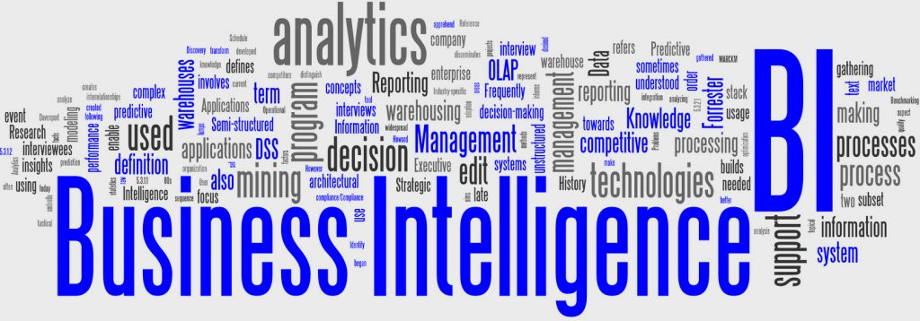
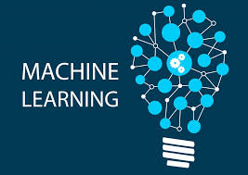
DSE Analytics: BI versus ML
Shelf high/low, per product, per geo, per season
Which paid search traffic brings the most qualified registrants?
Will this customer churn ?
Which web page has the most first time visitors?
What is the bounce rate on a given page?
Should we issue this loan?
Online recommendations
Should we set price higher/lower ?
Notes:
Match the attributes on the right with the areas on the left-
From, https://www.quora.com/What-are-some-examples-of-questions-that-business-intelligence-might-be-asked-to-answer
Sample BI questions:
Where are my customers coming from web traffic wise?
Which paid search traffic brings the most qualified registrants?
What are the most popular products (searches)?
How many sales per customer?
How many repeat sales?
Number of unique visitors?
Which web page has the most first time visitors?
What is the bounce rate on that page?
Of the bounces, how many were legitimately interested and not drive-by customers, and as such were "real" bounces?
What is the life time value of my average customer (meaning how much revenue will I gain from the average consumer)?
From, https://www.redpixie.com/blog/examples-of-machine-learning
Sample ML topics-

Slide 4
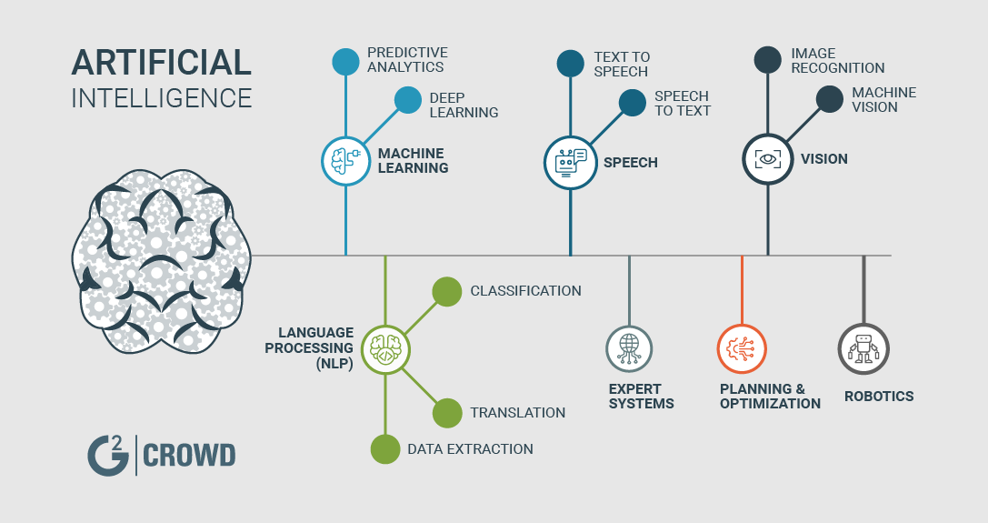
DSE Analytics: BI, ML, AI
An algorithm whose accuracy increases with the amount of data it receives
Device that perceives its environment and takes actions that maximize its chance of successfully achieving its goals
Frequent pattern matching
Historical, current and predictive views of business operations
Statistics: begin with a statistical population or a statistical model process to be studied
Notes:
Match the attributes on the right with the areas on the left-

Slide 5
End of Discussion Lab:
Notes:
End of Discussion Lab-

Slide 6
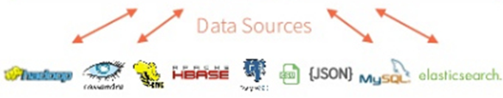
DSE Analytics: 5 Major Functional Areas
DataFrames
ML Pipelines
Spark SQL
Mllib/ML
GraphX
Spark Streaming
Spark Core
Image Source: DataBricks.com
Notes:
There is the main Spark engine (core), and on top of it fits Spark’s 4 main modules: 4 + 1 == 5
(Some diagrams will also highlight a 5'th main module, Spark/R.)
Spark SQL and Data Frames
Gives SQL like access to data, many ANSI standards implemented
Can access Hive, Avro, Parquet, ORC, JSON, and JDBC
Allows you to join across the various data sources
No ETL needed to process data
Spark Streaming
Often used with Kafka
Native APIs for Java, Scala and Python
MLlib (machine learning)
Machine Learning and all the goodness
that implies
GraphX with GraphFrames
DSE graph ties into GraphFrames
May optimize certain type of DSE Graph
Jobs
Reference Urls,
https://mapr.com/blog/5-minute-guide-understanding-significance-apache-spark/

Slide 7
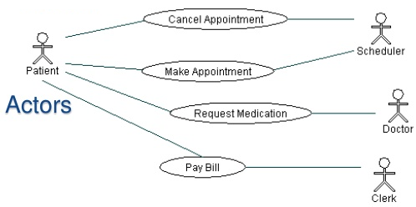
DSE Analytics: ML Use Cases-
Spam Detection/Filtering
Anomaly/Outlier Detection
Credit Card Fraud Detection
Voice Recognition
Digit/character recognition
Internet of Things
Gaming Analytics
Face Detection
Product Recommendation
Stock Trading
Churn
Notes:
Common/current machine language uses cases listed above.

Slide 8


DSE Analytics: ML Use Cases, Emerging-
Privacy Preserving Data Mining
Author Name Disambiguation
Recommendation Systems
Text Mining (e.g. plagiarism)
Sentiment Analysis
Speech Understanding
Why ? Application ?
Notes:
A larger area of growth for machine learning is NLP; natural language processing
If an insurance company saw post on social media that said:
"After 13 years, I think my baby finally needs to retire, and the post includes a picture of a really old Honda Civic; what might the bank try to sell this person ?

Slide 9
DSE Analytics: ML Enablers-
Though machine learning has been around for a while, lately there has been a surge in the need and use of machine learning
Big data, creating a superabundance of data to analyze
Ability for distributed systems like Spark to allow commodity computing systems to work together, instead of legacy, pricier systems
Changes in processing power, price of RAM, allow machines to crunch through their algorithms in a reasonable amount of time
Starting with Spark 2.0, Machine Learning updated to utilize spark.ml/DataFrame libraries instead of the spark.mllib/RDD based libraries
Notes:
Technologies and conditions that enable increased machine learning.
Reference Urls,
https://spark.apache.org/docs/preview/mllib-guide.html

Slide 10
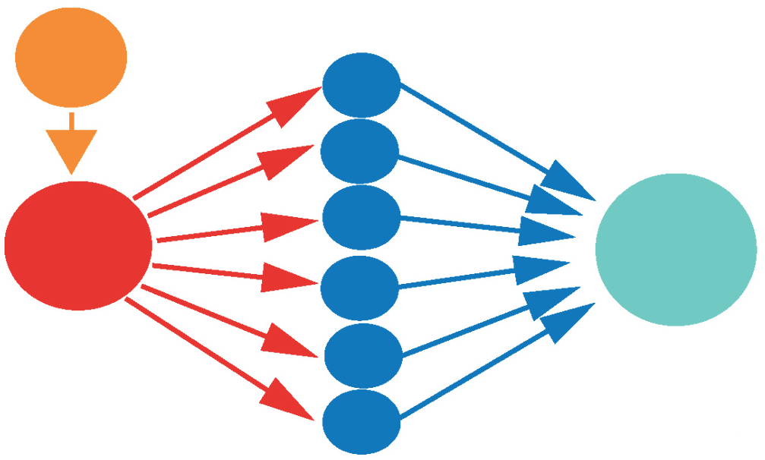
DSE Analytics: Libraries, MLlib/RDD, ML/DataFrame
Java, Scala, Python (Spark 0.9), R (Spark 1.5)
Fully Parallel/Performant
Was RDD; Spark 2.0, in maint. mode (now DF)
Most examples still MLlib/RDD, not ML/DF
Main doc page Url on Notes Page
Notes:
State of the state relative to Spark/ML.
Reference Urls,
Main doc page, https://spark.apache.org/docs/latest/ml-guide.html

Slide 11
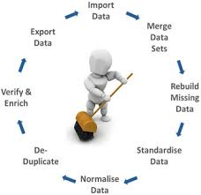
DSE Analytics: Process
Use known sample data to build a model, training phase (batch)
Apply model to achieve business goal, scoring phase (streaming, live)
Each ML routine can have a different model; a single array of terms, a K/V array, other, but always structured
Data quality of the training dataset is key
Data selection; often make assumptions on data as you build your process, be sure to note and go back to validate assumptions later
Data munging; preprocessing, transformation
Notes:
A high level discussion of the machine learning software development lifecycle.

Slide 12
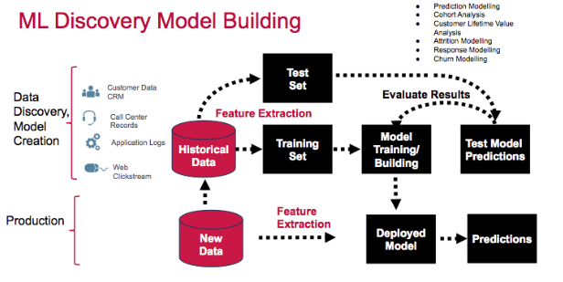
DSE Analytics: Process
Image Source: https://mapr.com/blog/churn-prediction-sparkml/
Notes:
A high level discussion of the machine learning software development lifecycle.

Slide 13

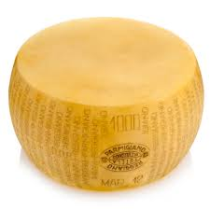
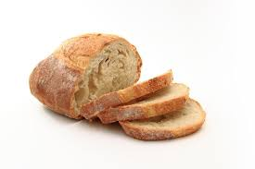
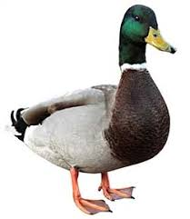
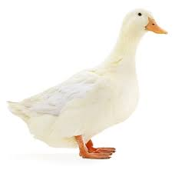
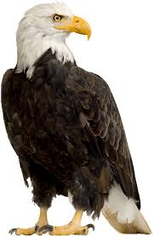
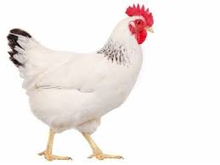
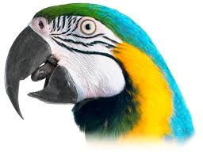
DSE Analytics: Process
+
=?
Training phase may be computationally intensive (CI), or not
Generally, a routine with CI training phase, has a relatively computationally efficient (CE) scoring phase
[
]
?
Notes:
Relative to the above:
The first model would have been calculated by measuring each product pair/tri/quad/..; in what percentage of cases is wine and cheese accompanied by bread. If the user selected wine and cheese, we might suggest bread. This would be a key/value lookup.
You might solve this challenge using an Apriori algorithm, discussed later.
The second model records characteristics about each individual set member; beak size, web feet yes or no, weight, wing span, other. As a new choice arrives, we measure it, then compare these measures to each known member of the model, and determine which is most similar.
You might solve this challenge using Knn, K-nearest neighbors, a clustering algorithm.
Notice that each of these measures was numeric, or boolean; a point that comes up later.

Slide 14
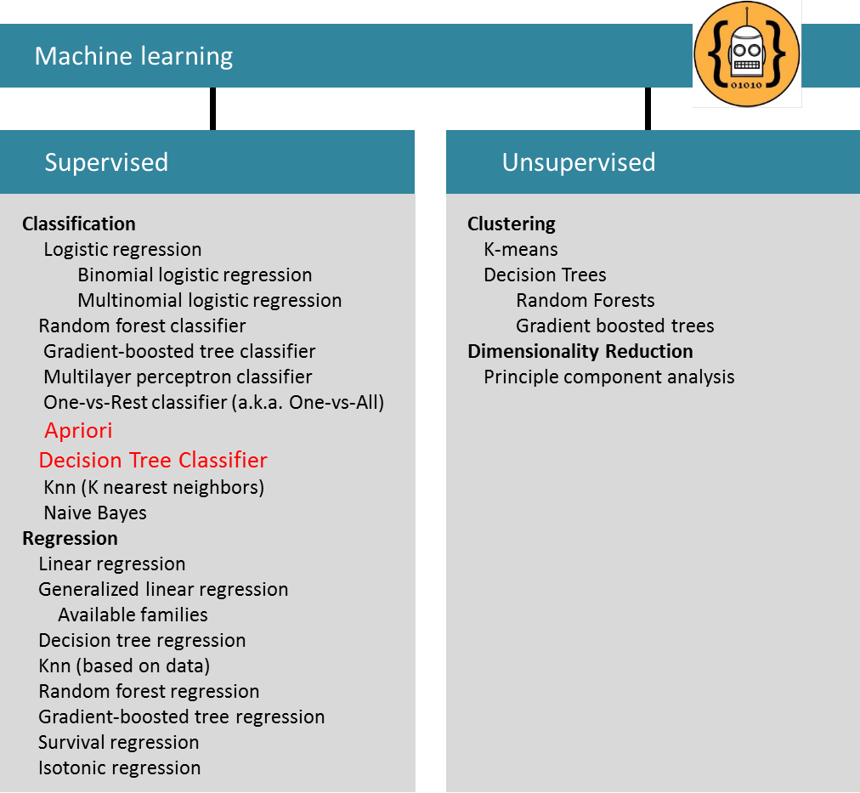
DSE Analytics: MLLib/ML categories
Supervised; known/labeled columns
Case 1; Classification, Nominal values (T|F, reptile|fish|amphib, ..)
Case 2: Regression, Infinite numeric values
Example case 1; frequency pattern matching
Knn; (seminal use case/example, bird identification)
Unsupervised; unlabeled columns
Generate clusters of data
Often used for discovery, to gain discovery, find outliers
Notes:
The document above is approximate; net/net, Spark ML supports what it supports, and routines come, go, advance, regress.
The purpose of the diagram above is to introduce:
Top down, machine learning categorizes its routines into supervised and unsupervised.
Supervised; target variable, 2 cases-
Case 1: Classification, Nominal values, T|F, (reptile, fish, mammal, ..),
Case 2: Regression, Infinite numeric values
Frequency pattern matching is an example of supervised learning, and is further subcategorized as classification.
In supervised learning, generally, you supply a single or set of well defined columns to a machine learning routine, analysis is performed, a model is output, and then the model is used for scoring.
In unsupervised learning, you may not know precisely what is contained in the columns you supply (the official terminology being, these are unlabeled columns), what the output may be, or whether the output is even useful.
Above we referenced the K-nearest neighbors (Knn), a supervised classification/regression machine learning algorithm, to detect (classify) an unknown bird identity. To be more precise, we would have supplied bird data to a Knn routine and asked that routine to generate classes of data (groups of data). If we asked for two groups of data to be output, we might have received marine birds and non-marine birds. Or, the data may have produced meat eaters and non-meat eaters. The output of Knn would not have stated or even known what meat or marine is. Knn what have produced the two groups as the mathematically cleanest distinction of two groups of data.

Slide 15
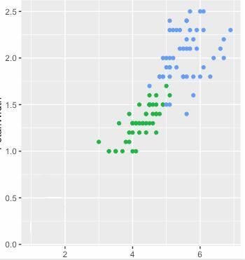
Sample: Supervised, Classification/Regression, Knn
Attribution, graphing
x, y, (z ?), .. input, "features"
Real world; normally 70-90% overlapping in first attempts
Outliers, patterns, more
Next step: add/remove columns
Ask for more/fewer groups, "labels"
Example; find relationship between columns involved in churn- What should you be looking for out of 100+ enterprise database columns
Notes:
Knn is most commonly used in a attribution process; given a known condition (persons who churn), what identifies these persons, what do they have in common.
If a cable DSL customer:
Reboots their modem 3 times in one morning, hits the Web site near "DSL troubleshooting", and queries the Web site with the query term, "how to cancel service", what type of customer service specialist should we route them to when the call ?

Slide 16
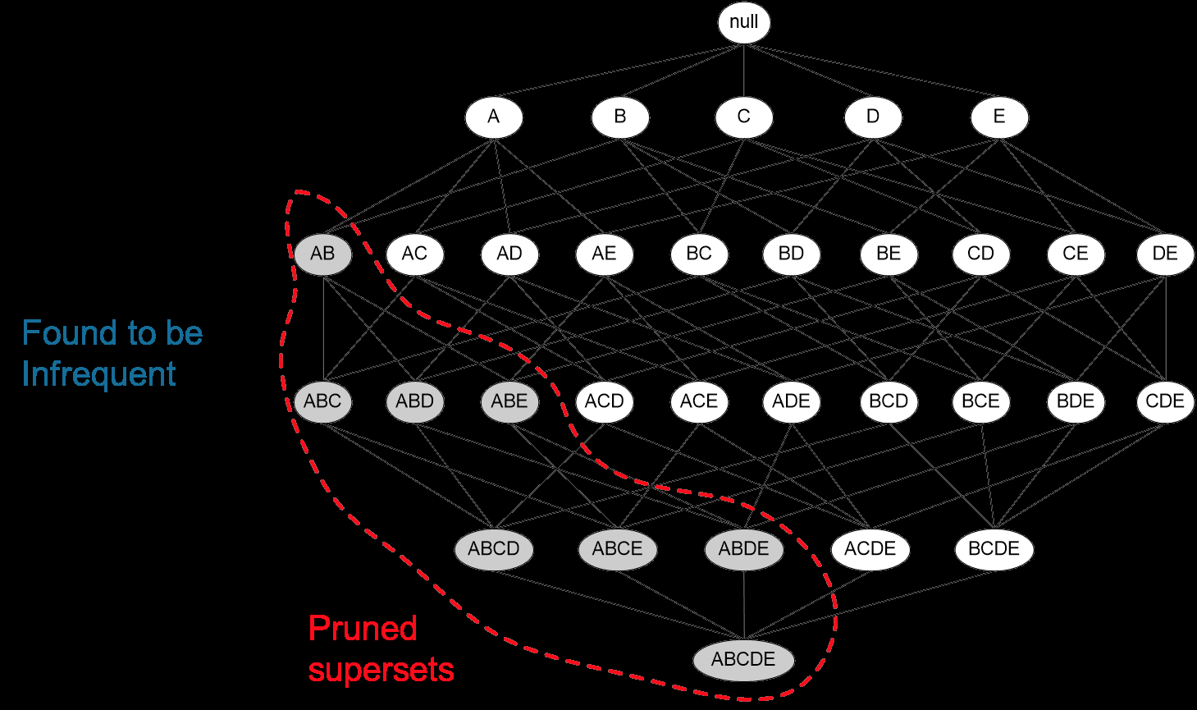
Machine Learning:
Upselling / Customers who bought (x) also bought (y), using the Apriori Algorithm
Notes:
Entering a section on the Apriori algorithm; frequency pattern matching, supervised learning.

Slide 17

Machine Learning: Apriori Algorithm
Tx num Items sold
---------- ----------------------------------------
0 soy milk, lettuce
1 lettuce, diapers, wine, chard
2 soy milk, diapers, wine, OJ
3 lettuce, soy milk, diapers, wine
4 lettuce, soy milk, diapers, OJ
Item Set
Item Set
Order Set
Notes:
The sample data set we use over the next few pages:
5 total orders.
Items on each order.
Soy milk appears on 4 orders, diapers on 4 orders, soy and diapers appear on 3 orders together.

Slide 18

Apriori
Support: percentage of dataset that contains given item set.
Soy-milk/diapers is 3 (item set) /5 (dataset).
Confidence: support (A/B) / support (A)
(diapers, soy-milk) / (diapers) == ( 3/5) / (4/5) == 75%
Low support ? We just don't have frequent data,
not a good candidate for this type of analysis ?
Confidence, with good support, useful
A dataset with N items can generate 2 ^ N -1 (power of) possible item sets
2 ^ 100 -1 == 1267650600228229401496703205375
We need to prune/optimize
Some similarity across, but each ML routine may have its own (vocabulary)
Items
Notes:
Relative to the above:
Support is defined as the percentage of the dataset (in this case: a list of orders, 5 count), that contains a given item set (soy/diapers, 3 of 5, or 60%).
Confidence is how defined as how (frequently this occurs). In this example; if the user buys diapers, How likely are they to buy soy ?

Slide 19
Apriori
How-
Generate a list of all unique items (singles)
Generate a list of all unique (item pairs, and higher)
soy -> lettuce (tx 0)
soy -> diapers (tx 2)
soy -> diapers, wine (tx 2)
soy -> diapers, wine, OJ (tx 2)
...
Calculate support and confidence for each
Apriori-
If A/B is (in)frequent, then A/B/C, A/B/D, and A/B/C/D are also (in)frequent (so discard them)
Association rules: antecedent -> consequent
diapers -> chard (1/5 diapers-chard) / (4/5 diapers) = 25%
chard -> diapers (1/5 diapers-chard) / (1/5 chard) = 100%
Is it statistically significant
Created from 2 or more items
Notes:
The Apriori algorithm title derives from a Latin term and means, from before. In the description of the algorithm, we will highlight where the “from before” behavior (optimization) of this algorithm presents itself.
The data set in total contains five grocery store orders. The first order has two items; soy milk and lettuce. We see that four of the five orders contain soy milk; orders zero, and two through four.
The first task in the delivery of the Apriori algorithm is to walk once (loop) through the list of orders and generate a unique list of single items.
In this example, this effort produces six unique single items; soy milk, lettuce, diapers, wine, chard (a type of beet), and OJ (orange juice).
As a result of this processing we also know the number of total orders in the data set, a number we will use often.
Why do we generate a unique list of single items ?
The official name of the list is, “candidate item set of size 1”, or C1.
From this list (C1), we can generate the possible list of item pairs (C2, orders with 2 items, the candidate item set of size 2), the possible list of item triplets (C3, orders with 3 items), and so on.
Again, why are we creating these lists; aren’t these combinations already in our order set data ? Yes, but. The manner in which we create this lists is highly efficient, indexed and in memory. If we build these lists as we read and process the orders data set, we’ll be performing constant re-shuffling and bubble sorts, yadda.
Generating these lists ourselves is faster, and in a moment you will see why.
There are really just two more keywords (variables) we have to define (support and confidence), and then you will have the bulk of understanding related to Apriori-
Support is defined as the item set count divided by the total order count.
– Soy milk appears in 4 of 5 orders, and its “support” value is 4 / 5 == 80%.
– Chard appears in only 1 of 5 orders, and its support value is, 1 / 5 == 20%.
– Diapers / Wine appears in 3 of 5 orders, and its support value is 3 / 5 == 60%.
We want to look at frequent item sets, and support is a value used to that end.
Our second task is to take C1, and generate a list of items pairs (C2). We generate C2 from C1 using a nested loop, super fast.
Thus far all we have been doing is generating internal control structures in memory, inside our analysis routine. Now the fun begins.
We generate items pairs (C2) from C1 because this is the first time we are discussing performing this task in the dialog of this document.
On subsequent/further processing, C2 will be used to generate C3, C3 generates C4, and so on, using this same function.
We write this function so that it is re-entrant; so that we may pass (custom, or reduced) C(n) lists. Why ? Code optimization for one; write less application program code. But also you will see in a moment we will start pruning these lists C2, C3, etcetera, as given items sets display (weak relationships).
Our third task is to take C2 and evaluate it, to score it. Remember “support” ? Our sample (and small) data set has only five orders. As such, chard seems to have a really high support value of 20%. In the real world your data sets will have hundreds of thousands (or millions) of orders, and if something is only purchased 0.0002% of the time (a very low support value), you want to discard further processing of it. Why ? From an earlier slide, is a formula that displays how large possible (candidate) item sets can grow. A data set (list of orders) with 100 unique items (a C1), can generate,
2 ^ 100 -1 == 1267650600228229401496703205375 item sets
The caret (^) above means; 2 to the power of (100).
If items have very low support values, we remove them from the candidate item set for efficiency. Also, these items are just not frequently purchased; why even consider up selling them ?
The first of our two defined (variables) was support. Now we define confidence.
Order number two contains the items (item set); soy milk, diapers, and wine (and OJ). If someone is only currently holding the item diapers, how certain can we be that they may also purchase wine ?
An example will help-
The diapers (A) and wine (B) item set occurs in 3 of 5 total orders, a support value of 3 / 5 == 60%.
Diapers (A) alone (as an item set) occurs in 4 of 5 total orders, a support value of 4 / 5 == 80%
Confidence is defined as, support (A,B) / support (A)
(diapers-A, wine-B) / (diapers-A) == (3/5) / (4/5) == 75%
T
Thus we can say, from order history; we are 75% confident that a diaper user will also buy wine. 75% is our confidence level.
Just to be excessively verbose-
The left side of that equation is called the antecedent, and the right side is called the subsequent.
Human behavior certainly, we can not state why diaper users buy wine, but the data displays that they do.
Also, notice that the relationship of wine to diapers is different than diapers to wine, because the support value for wine is different; this relationship is directional. Don’t get hung up on the answer, as this data set is ridiculously small and inaccurate.
Fourth and final tasks-
We have the gist of things already covered:
• We generate C1, and use this to generate C2, C3 generates C3, and so on.
• We use support and confidence to prune C2 on down.
Recall that Apriori is Latin for “from before” ?
If a given item set is pruned from C(n) because low support or confidence, it also does not get passed down to C(n+1). If folks aren’t buying prunes (low support), why should we expect they buy prunes and beer ? If we have low confidence that folks buy prunes, beer and then Danishes, why would we expect with high confidence prunes, beer, danish and then tissues ?
The “from before” reference is made to the manner in which we prune candidate item sets; prune from what we have seen upstream in the derived data.
Another final task is to output association rules, which are just the stated relationship of confidence level, and an antecedent and consequent item set; example, (diapers --> wine, 75%).
Where we had candidate item set 1 (C1), producing C2, and so on, we need to mention that the scored (reduced by support and confidence) item sets are generally referred to as, L1, L2, etcetera.

Slide 20
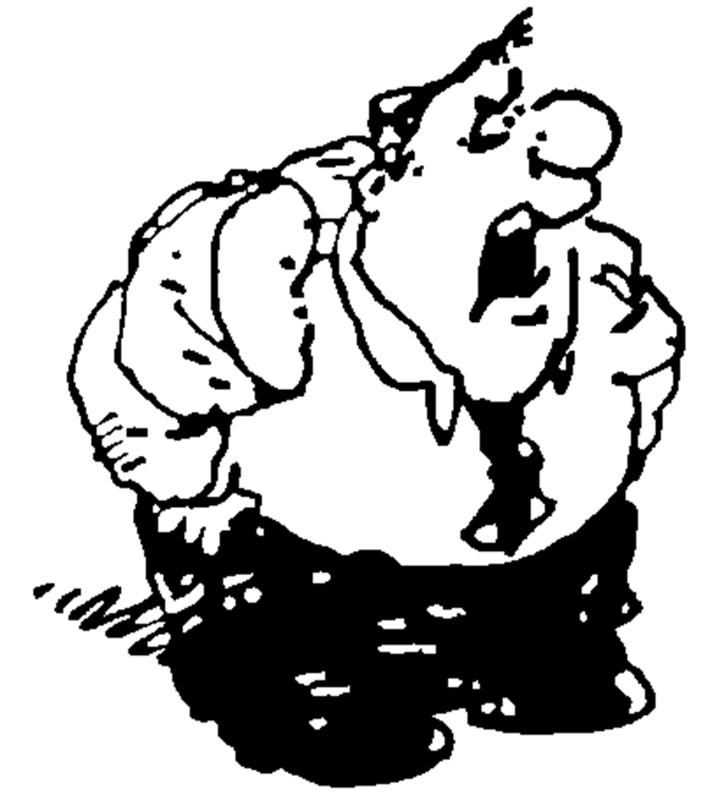
Working Goal:
From: Maury_Atwater
To: DSE_HOTSHOT
Subject: Need this now !!!
We need to start upselling ! CSV file; 10k orders, 43k items sold, 170 unique items, 4.4 items per transaction.
We need a set of association rules to apply on the Web site !
-MA
Maury Atwater, President of Atwater's
Notes:
The email above, lists our working goal.

Slide 21
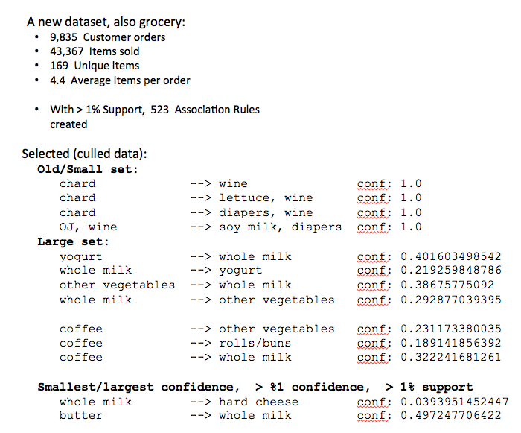
Apriori: New data set
Notes:
We’d love to credit where we downloaded this larger data set from (probably from one of the Apache Spark pages), but we’ve lost that link. Sorry.
10,000+/- orders, and at some point this data was likely real; the confidence levels and related association rules seem to make sense.
9,835 total orders, 43,367 total items sold, 169 unique items, 4.4 average items per order.
With a requested 1% support level, we can generate 523 association rules.
Using real’ish data, we see that the highest observed confidence level in this data set was butter to whole milk, at nearly 50%.The lowest observed confidence level (still though with a support level of 1% or higher), was whole milk to hard cheese at less then 4% confidence.

Slide 22
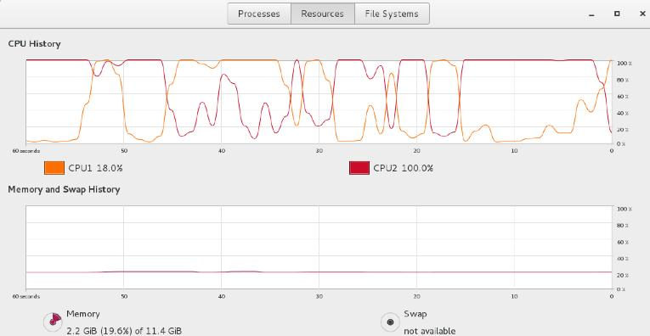
Apriori: If you hand coded in Python, other
All manual Python code, 809 lines
Large data set, killed it after 1 hour
Using Spark/Python libraries, 54 lines of code
Large data set, laptop/VM, 2 cores, 20 seconds
Notes:
If you hand coded the Apriori in simple Python:
We supply this file, if you wish to investigate.
Single threaded by default, pipelined parallelism (Spark/ML), is non-trivial. In the graph above, notice only one CPU is active at a time.
809 lines, with generous comments
Small data set, completes. Large data set, killed after one hour.
Spark/ML libraries only, 66 lines
Full on Spark/Scala/ML, 88 lines
Both above; completes in seconds on large data set.

Slide 23
Coding the Apriori
Customers who bought (x) bought (y)
Notes:
Entering a section on how to code the Apriori algorithm.

Slide 24
Apriori: In Python, Pg 1 of 2
from pyspark.mllib.fpm import FPGrowth
from pyspark import SparkContext
sc = SparkContext()
l_datafile = sc.textFile("10_grocery.csv")
l_orders = l_datafile.map(lambda line: line.strip().split(','))
l_model = FPGrowth.train(l_orders, minSupport=0.01, numPartitions=1)
l_results = l_model.freqItemsets().collect()
# l_results is of type: <class 'collections.FreqItemset'>
What is the 0.01 here ?
Notes:
All of the code that follows is documented at,
https://spark.apache.org/docs/latest/mllib-frequent-pattern-mining.html
October/2017-
From,
https://spark.apache.org/docs/1.6.0/mllib-frequent-pattern-mining.html
http://spark.apache.org/docs/2.0.2/api/python/_modules/pyspark/mllib/fpm.html
The Spark MLlib/Apriori library has methods to calculate support. This same library is not complete. and does not include methods to calculate association rules. There is a Jira for this, and they are working on it, but ..
https://issues.apache.org/jira/browse/SPARK-14501

Slide 25
Apriori: In Python, Pg 2 of 2
for l_result in l_results:
print str(l_result[0]) + " " + str(float(l_result[1]) / 100)
# From Spark,
# [u'whole milk'] 0.2513
# [u'other vegetables'] 0.1903
# [u'rolls/buns'] 0.1809
#
# From pure Python,
# frozenset(['whole milk']) 0.255516014235
# frozenset(['other vegetables']) 0.193492628368
# frozenset(['rolls/buns']) 0.183934926284
0 == (label)
1 == (support)
Python currently: You have to calculate confidence and association rules yourself. Not awful, but ..
Notes:
October/2017-
From,
https://spark.apache.org/docs/1.6.0/mllib-frequent-pattern-mining.html
http://spark.apache.org/docs/2.0.2/api/python/_modules/pyspark/mllib/fpm.html
The Spark MLlib/Apriori library has methods to calculate support. This same library is not complete. and does not include methods to calculate association rules. There is a Jira for this, and they are working on it, but ..
https://issues.apache.org/jira/browse/SPARK-14501

Slide 26
Apriori: In Scala, 1/6
package com.datastax.enablement.bootcamp
import org.apache.spark.{SparkConf, SparkContext}
import org.apache.spark.mllib.fpm.FPGrowth
import org.apache.spark.rdd.RDD
import org.apache.spark.mllib.fpm.AssociationRules
And others if you expand scope
Notes:
The imports needed to support this program are listed above.
All of the code that follows is documented at,
https://spark.apache.org/docs/latest/mllib-frequent-pattern-mining.html

Slide 27
Apriori: In Scala, 2/6
object App {
def main(args: Array[String]) {
val sc = new SparkContext(new SparkConf().
setAppName("My App"))
val data = sc.textFile("file:///opt/dse_ml/10_grocery.csv")
val transactions: RDD[Array[String]] = data.
map(s => s.trim.split(','))
// Sample data lines from CSV
// citrus fruit,semi-finished bread,margarine,ready soups
// tropical fruit,yogurt,coffee
Any ML yet ?
Notes:
All of the code above is to prepare the data; put the data in the format expected by the library receiving it.

Slide 28
Apriori: In Scala, 3/6
val fpg = new FPGrowth().setMinSupport(0.01).
setNumPartitions(1)
val model = fpg.run(transactions)
model.freqItemsets.collect().foreach { itemset =>
println(itemset.items.mkString("[", ",", "]") +
", " + itemset.freq)
}
// {canned vegetables}: 106
// {pork}: 567
//
// 99 {curd,yogurt,whole milk}
// 2513 {whole milk}
// class org.apache.spark.mllib.fpm.FPGrowth$FreqItemset;
Python was train() ?
Data from println()
The actual high/low
Notes:
From the documentation:
Due to lazy evaluation, run() is not actually "run"; run() is a transform. How do you know this ? The presence of collect() on the line that follows.
Per the documentation, run() eventually returns an RDD (it's an RDD library). A root level element of the array/structure returned from run() is titled, freqItemsets, with further subdivisions.

Slide 29
Apriori: In Scala, 4/6
val minConfidence = 0.8
model.generateAssociationRules(minConfidence).
collect().foreach { rule =>
println(
rule.antecedent.mkString("[", ",", "]")
+ " => " + rule.consequent .mkString("[", ",", "]")
+ ", " + rule.confidence
)
}
Difference between this page and the next page ?
Notes:
Relative to the example above:
generateAssociationRules() is also a transform; again, the presence of collect() that follows. antecedent, consequent, and confidence are attributes to the RDD that is returned.
Scala (or Python, ..) question; what does the variable/value "model" refer to ? (Answer: a subset of a DAG, transforms short of an action.) So, a portion of model is executed twice, as the code exists currently. What action might we insert before the two collect()s ?

Slide 30
Apriori: In Scala, 5/6
println("")
println("")
val ar = new AssociationRules().setMinConfidence(0.1)
val results = ar.run(model.freqItemsets)
results.collect().foreach { rule =>
println("[" + rule.antecedent.mkString(",")
+ "=>"
+ rule.consequent.mkString(",") + "]," +
rule.confidence
)
}
Notes:
AssociationRules().run() is used to produce a new set of association rules from the frequent item set; essentially, a re-ranking and/or outputting a new/different set of association rules.

Slide 31

Apriori: In Scala, 6/6
sc.stop()
sys.exit(0)
}
}
// High low,
// 0.10074626865671642 {root vegetables} => {pastry}
// 0.10167910447761194 {root vegetables} => {margarine}
// ...
// 0.5845410628019324 {tropical fruit,root vegetables} => {other vegetables}
// 0.5862068965517241 {citrus fruit,root vegetables} => {other vegetables}
//
// class org.apache.spark.mllib.fpm.AssociationRules$Rule
Notes:
And closing the DSE Analytics (Apache Spark) question.

Slide 32
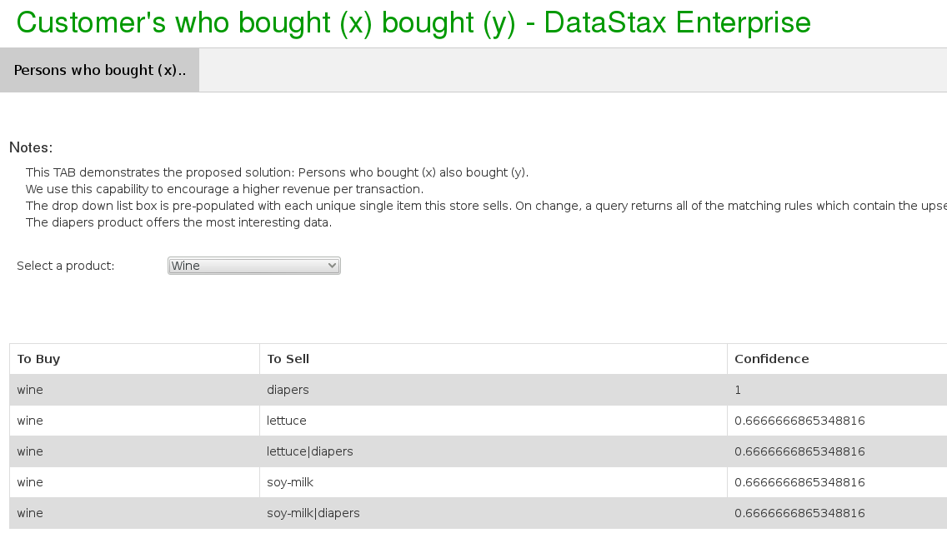
Apriori: Application
Notes:
Application of an Apriori (frequent pattern association):
As stated, training-phase/scoring-phase, which is computationally intensive (CI) ? Apriori is training-phase CI.
So we batch first, build the association rules; store inside DSE.
In the Web site, live/real-time, we asynchronously monitor the shopping cart. The cart has contents (left column, "To Buy"), and on change we query a DSE Core primary key equality; Do we have a recommendation (with confidence) on the contents of this cart ?

Slide 33
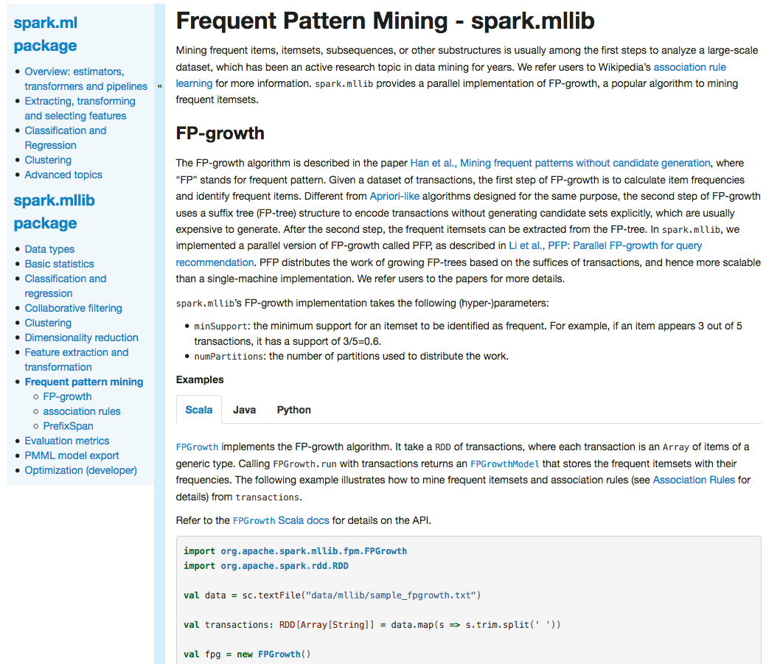
How would you know this
Url on Notes page
And this example
Notes:
Reference Urls,
https://spark.apache.org/docs/latest/mllib-frequent-pattern-mining.html

Slide 34
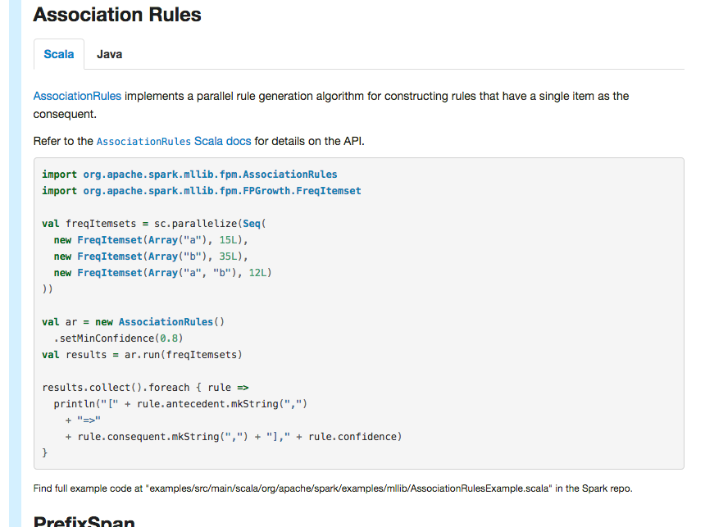
How would you know this
No Python TAB ?
Notes:
Reference Urls,
https://spark.apache.org/docs/latest/mllib-frequent-pattern-mining.html

Slide 35
Apriori: Summary
order set, item set
support
confidence
association rules
antecedent, consequent
C1, candidate item set of size 1
C2, ..
L2, frequent item set (scored, size 2)
FPGrowth.run()
FPGrowth.train()
freqItemsets
(0 == label, 1 == confidence)
freqItemsets.items
freqItemsets.freq
AssociationRules.run()
antecedent
consequent
confidence
Notes:
Reference Urls,
https://en.wikipedia.org/wiki/Association_rule_learning
https://spark.apache.org/docs/latest/mllib-frequent-pattern-mining.html

Slide 36

Machine Learning:
Predicting Customer Churn using Decision Tree Classifier
Notes:
Entering a section on the Decision Tree Classification; supervised learning.

Slide 37
Customer Churn/Attrition
Banks, telephone service companies, Internet service providers, pay TV companies, insurance firms, and alarm monitoring services, often use customer attrition analysis and customer attrition rates as one of their key business metrics (along with cash flow, EBITDA, etc.) because the cost of retaining an existing customer is far less than acquiring a new one.
Companies from these sectors often have customer service branches which attempt to win back defecting clients, ...
Reference Url:https://en.wikipedia.org/wiki/Customer_attrition
Notes:
Definition of customer churn/attrition.
Reference Urls,
https://en.wikipedia.org/wiki/Customer_attrition

Slide 38
Churn: Data required
In order to understand the customer, a number of factors can be analyzed, such as:
Customer demographic data (age, marital status, etc.)
Sentiment analysis of social media
Customer usage patterns and geographical usage trends
Calling-circle data
Browsing behavior from clickstream logs
Support call center statistics
Historical data that show patterns of behavior that suggest churn
Notes:
The basic question becomes: do we have the data we need in order to answer the question ?
Reference Urls,
https://mapr.com/blog/churn-prediction-sparkml/

Slide 39

Churn Example: USA, Dish Network
Customer/360 (Need the data)
You rebooted your modem twice that morning
You accessed the pricing page on the Web site
You queried "cancel service" on the Web page
Now you're in the VRU/800-number
Which of 30,000 CSRs do we route you to ?
Notes:
Internal use only: not reference able, application not hosted on DataStax/DSE
This is a real world application:
Through data science; what top (n) profiles exist of someone ready to churn
Identify the customer when they call, route to a customer service agent specially trained on that use case; measure results and coach/refine

Slide 40
Churn: Atwater's data
CREATE TABLE orders
order_num
order_date
customer_num
ship_instruct
backlog
po_num
ship_date
ship_weight
ship_charge
paid_date
CREATE TABLE items
item_num
order_num
stock_num
manu_code
quantity
total_price
CREATE TABLE customer
customer_num
fname
lname
company
address1
address2
city
state
zipcode
phone
Notes:
The basic question becomes: Does Atwater's possess the data necessary to deliver customer churn ?

Slide 41
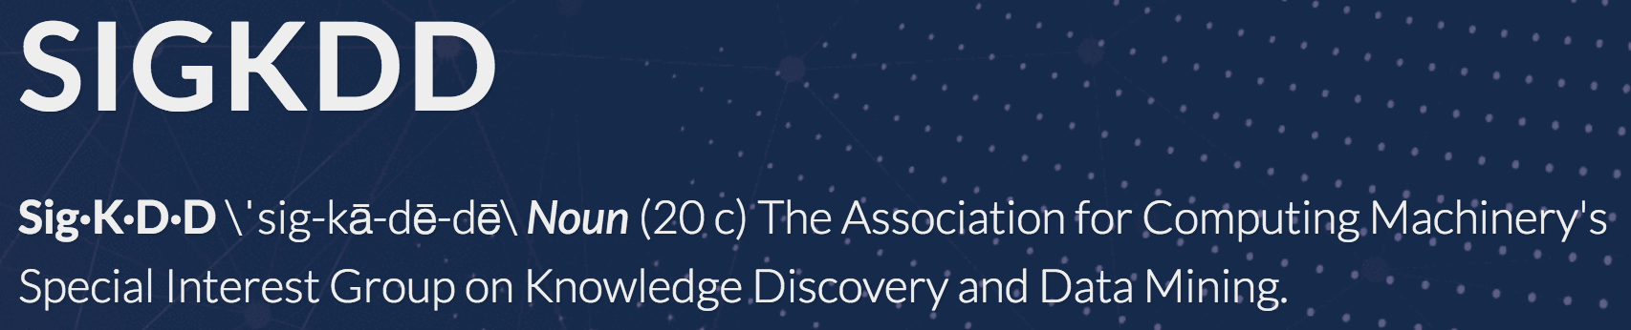
Churn
Yearly contest, specifically 2009, focus was Churn
"The challenge (was) to beat the in-house system developed by Orange Labs." A.k.a, Orange Telecomm (https://www.orange.com/en/home)
3000+ real data rows (customer ID cleansed)
262 lines of Scala
Will this customer churn ?
Notes:
SIGKDD holds a yearly contest/summit related to data mining, data science. In 2009, the primary challenge was related to churn. Orange Telecomm donated cleansed but real data in the area of customer churn. The challenge was to beat (better model) Orange customer churn.
This is the example we follow over the next few pages.
Reference Urls,
http://www.kdd.org/kdd-cup/view/kdd-cup-2009

Slide 42
Churn: Data model, telecomm
State
Account length
Area code
International plan
Voice mail plan
Number vmail messages
Total day minutes
Total day calls
Total day charge
Total eve minutes
LA,117,408,No,No,0,184.5,97,31.37,351.6,80,29.89,215.8,90,9.71,8.7,4,2.35,1,False
IN,65,415,No,No,0,129.1,137,21.95,228.5,83,19.42,208.8,111,9.4,12.7,6,3.43,4,True
Total eve calls
Total eve charge
Total night minutes
Total night calls
Total night charge
Total intl minutes
Total intl calls
Total intl charge
Customer service calls
Churn (Did they churn (label): T|F)
Notes:
The data and model supplied by Orange is listed above.

Slide 43
Coding the Decision Tree Classifier
Will this customer churn ?
Notes:
Entering a section on how to code the Decision Tree Classifier algorithm; will this customer churn ?
This example sourced from,
https://mapr.com/blog/churn-prediction-sparkml/
https://github.com/caroljmcdonald/mapr-sparkml-churn

Slide 44
Churn: In Scala 1 of 14
package com.datastax.enablement.bootcamp
import org.apache.spark.sql.SparkSession
import org.apache.spark.sql.functions._
import org.apache.spark.sql.types._
import org.apache.spark.sql.Dataset
import org.apache.spark.ml.Pipeline
import org.apache.spark.ml.classification.DecisionTreeClassifier
import org.apache.spark.ml.classification.DecisionTreeClassificationModel
import org.apache.spark.mllib.evaluation.BinaryClassificationMetrics
import org.apache.spark.ml.evaluation.BinaryClassificationEvaluator
import org.apache.spark.ml.feature.StringIndexer
import org.apache.spark.ml.tuning.ParamGridBuilder
import org.apache.spark.ml.tuning.CrossValidator
import org.apache.spark.ml.feature.VectorAssembler
Notes:
The imports/packages required for Decision Tree Classifier.

Slide 45
Churn: In Scala 2 of 14
object App {
case class Account
(
state: String,
len: Integer,
acode: String,
intlplan: String,
vplan: String,
numvmail: Double,
tdmins: Double,
tdcalls: Double,
tdcharge: Double,
temins: Double,
tecalls: Double,
techarge: Double,
tnmins: Double,
tncalls: Double,
tncharge: Double,
timins: Double,
ticalls: Double,
ticharge: Double,
numcs: Double,
churn: String
)
Notes:
The example code uses a case class and a StructType.

Slide 46
Churn: In Scala 3 of 14
val schema = StructType(Array(
StructField("state", StringType, true),
StructField("len", IntegerType, true),
StructField("acode", StringType, true),
StructField("intlplan", StringType, true),
StructField("vplan", StringType, true),
StructField("numvmail", DoubleType, true),
StructField("tdmins", DoubleType, true),
...
StructField("tncharge", DoubleType, true),
StructField("timins", DoubleType, true),
StructField("ticalls", DoubleType, true),
StructField("ticharge", DoubleType, true),
StructField("numcs", DoubleType, true),
StructField("churn", StringType, true)
))
Notes:
The example code uses a case class and a StructType.

Slide 47
Churn: In Scala 4 of 14
def main(args: Array[String]) {
val spark: SparkSession = SparkSession.builder().
appName("churn").getOrCreate()
import spark.implicits._
val train: Dataset[Account] = spark.read.option(
"inferSchema", "false").
schema(schema).csv(
"file:///opt/dse_ml/churn-bigml-80.csv").
as[Account]
train.take(1)
train.cache
//
println(train.count)
Notes:
Zero code here relative to the actual ML library.

Slide 48
Churn: In Scala 5 of 14
val test: Dataset[Account] = spark.read.option(
"inferSchema", "false").
schema(schema).csv(
"file:///opt/dse_ml/churn-bigml-20.csv").
as[Account]
test.take(2)
println(test.count)
//
test.cache
train.printSchema()
train.show
train.createOrReplaceTempView("account")
spark.catalog.cacheTable("account")
train.groupBy("churn").count.show
Notes:
Zero code here relative to the actual ML library; but, using some Spark SQL function for diagnostics.

Slide 49
Churn: In Scala 6 of 14
val fractions = Map("False" -> .17, "True" -> 1.0)
// Here we're keeping all instances of the Churn=True class,
// but downsampling the Churn=False class to a fraction of 388/2278.
val strain = train.stat.sampleBy("churn", fractions, 36L)
//
strain.groupBy("churn").count.show
val ntrain = strain.drop("state").drop("acode").
drop("vplan").drop("tdcharge").drop("techarge")
println(ntrain.count)
ntrain.show
Notes:
groupBy(), sampleBy() are detailed on the next page; in effect, Decision Tree Classifier has a number of very strict input data requirements.

Slide 50
Spark: sampleBy()
Description: Returns a stratified sample without replacement based on the fraction given on each stratum.
Usage: sampleBy(x, col, fractions, seed)
// S4 method for signature 'SparkDataFrame,character,list,numeric'
sampleBy(x, col, fractions, seed)
Arguments:
x A SparkDataFrame
col column that defines strata
fractions A named list giving sampling fraction for each stratum. If a stratum is not specified, we treat
its fraction as zero.
seed random seed
Value: A new SparkDataFrame that represents the stratified sample
Notes:
Detailing sampleBy();
Reference Urls,
https://spark.apache.org/docs/2.1.1/api/R/sampleBy.html

Slide 51
Churn: In Scala 7 of 14
val ipindexer = new StringIndexer().
setInputCol("intlplan").
setOutputCol("iplanIndex")
val labelindexer = new StringIndexer().
setInputCol("churn").
setOutputCol("label")
val featureCols = Array("len", "iplanIndex",
"numvmail", "tdmins", "tdcalls", "temins",
"tecalls", "tnmins", "tncalls", "timins",
"ticalls", "numcs")
val assembler = new VectorAssembler().
setInputCols(featureCols).
setOutputCol("features")
val dTree = new DecisionTreeClassifier().
setLabelCol("label").
setFeaturesCol("features")
Notes:
StringIndexer(), VectorAssembler(); in effect, Decision Tree Classifier has a number of very strict input data requirements.
These two objects are not as complex as they sound; they're really just simple helper functions.

Slide 52
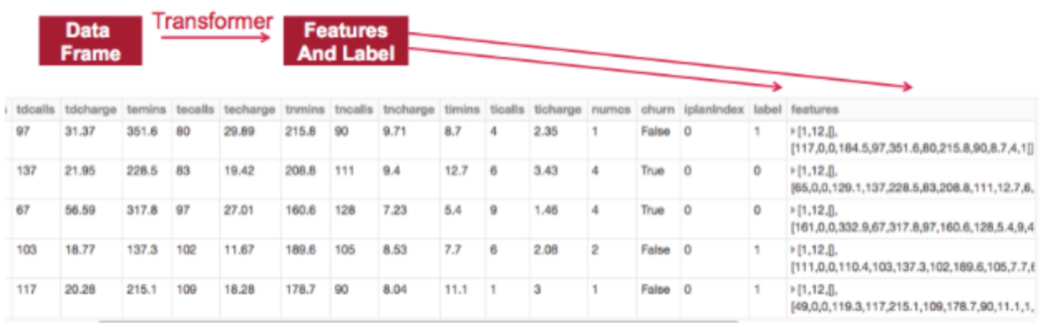
Spark: StringIndexer()
"The ML package needs data to be put in a (label: Double, features: Vector) DataFrame format with correspondingly named fields. We set up a pipeline to pass the data through 3 transformers in order to extract the features: 2 StringIndexers and a VectorAssembler. We use the StringIndexers to convert the String Categorial feature intlplan and label into number indices. Indexing categorical features allows decision trees to treat categorical features appropriately, improving performance.
Notes:
Detailing StringIndexer().
Reference Urls,
https://mapr.com/blog/churn-prediction-sparkml/

Slide 53
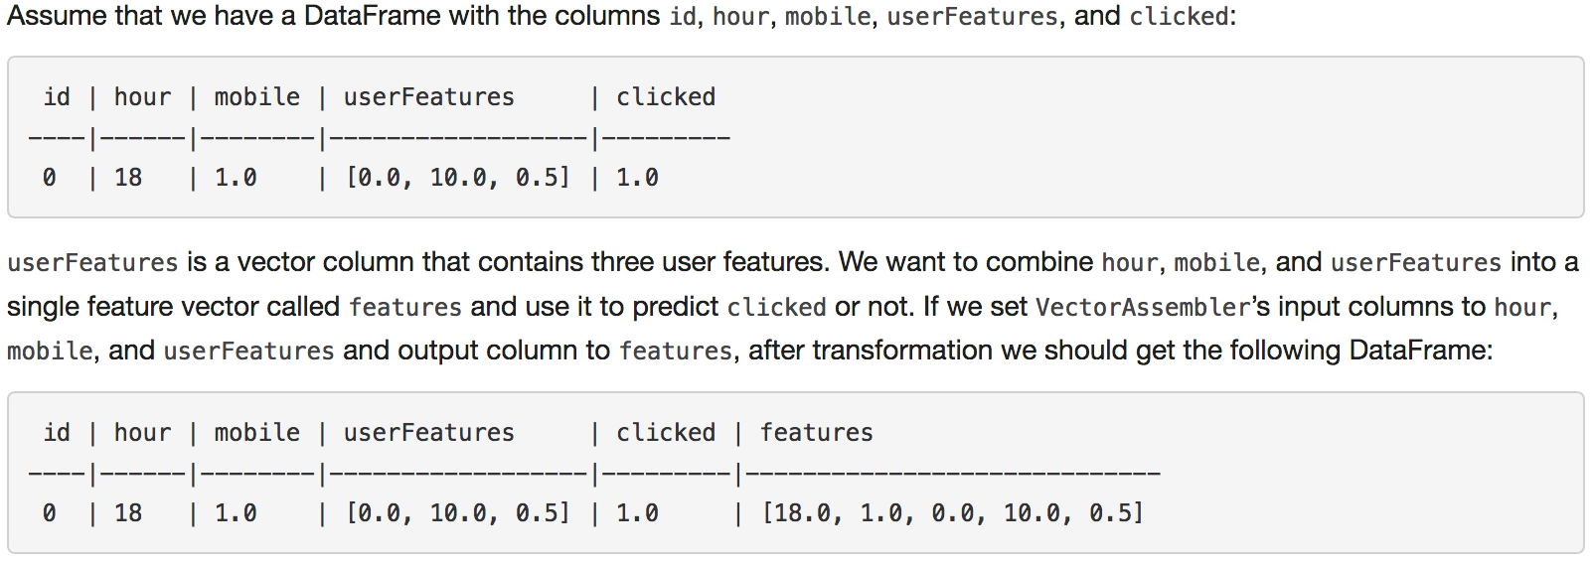
Spark: VectorAssembler()
VectorAssembler is a transformer that combines a given list of columns into a single vector column. It is useful for combining raw features and features generated by different feature transformers into a single feature vector, in order to train ML models like logistic regression and decision trees. VectorAssembler accepts the following input column types: all numeric types, boolean type, and vector type. In each row, the values of the input columns will be concatenated into a vector in the specified order.
Notes:
Detailing VectorAssembler().
Reference Urls,
https://mapr.com/blog/churn-prediction-sparkml/
https://spark.apache.org/docs/latest/ml-features.html#vectorassembler

Slide 54
Churn: In Scala 8 of 14
// Chain indexers and tree in a Pipeline.
val pipeline = new Pipeline().
setStages(Array(ipindexer, labelindexer,
assembler, dTree))
// Search through decision tree's maxDepth
// parameter for best model
val paramGrid = new ParamGridBuilder().
addGrid(dTree.maxDepth, Array(2, 3, 4,
5, 6, 7)).build()
val evaluator = new BinaryClassificationEvaluator().
setLabelCol("label").
setRawPredictionCol("prediction")
Notes:
Pipelines, detailed on the next page.
And three additional (common) ML library helpers; ParamGridBuilder, other.

Slide 55
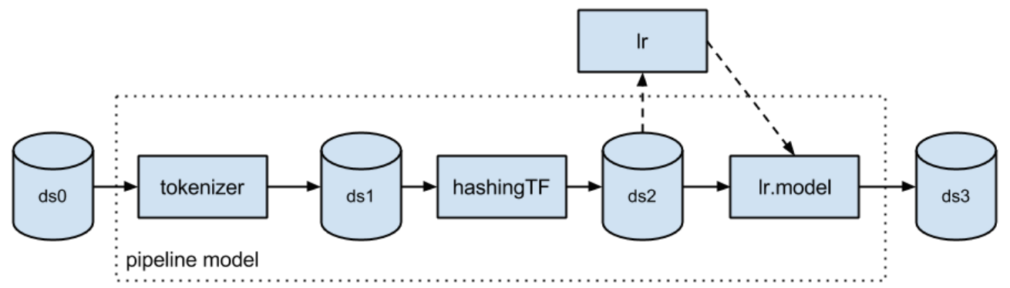
Spark: Pipeline()
The ML Pipelines is a High-Level API for MLlib that lives under the “spark.ml” package. A pipeline consists of a sequence of stages. There are two basic types of pipeline stages: Transformer and Estimator. A Transformer takes a dataset as input and produces an augmented dataset as output. E.g., a tokenizer is a Transformer that transforms a dataset with text into an dataset with tokenized words. An Estimator must be first fit on the input dataset to produce a model, which is a Transformer that transforms the input dataset. E.g., logistic regression is an Estimator that trains on a dataset with labels and features and produces a logistic regression model.
Notes:
ML pipelines:
More than a (macro) representing a number of stage, steps in the execution of our ML routines, pipelines allow the Catalyst DAG optimizer to better plan, memory manage, other, our job.
Also, as a (unit of work), the ML routine downstream will know where/how to restart when optimizing a model.
Reference Urls,
https://mapr.com/blog/churn-prediction-sparkml/
https://databricks.com/glossary/what-are-ml-pipelines

Slide 56
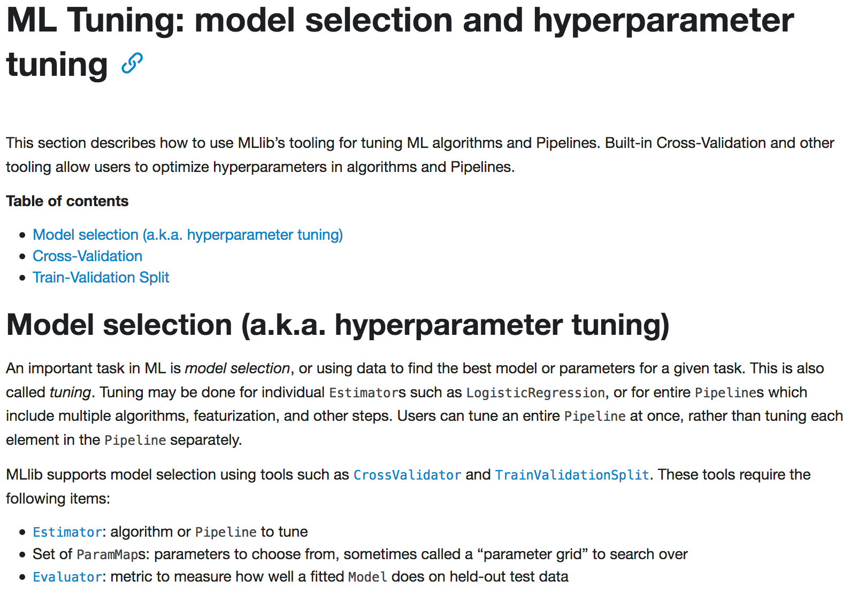
Spark: (Many)
ParamGridBuilder()
BinaryClassificationBuilder()
CrossValidator()
Notes:
A number of the additional helper functions in the area of Spark ML.
Reference Urls,
https://mapr.com/blog/churn-prediction-sparkml/
https://spark.apache.org/docs/latest/ml-tuning.html

Slide 57
Churn: In Scala 9 of 14
// Set up 3-fold cross validation
val crossval = new CrossValidator().
setEstimator(pipeline).
setEvaluator(evaluator).
setEstimatorParamMaps(paramGrid).
setNumFolds(3)
val cvModel = crossval.fit(ntrain)
val bestModel = cvModel.bestModel
println("The Best Model and Parameters:\n--------------------")
println(bestModel.asInstanceOf[
org.apache.spark.ml.PipelineModel].stages(3))
//
bestModel.asInstanceOf[org.apache.spark.ml.PipelineModel].
stages(3).
extractParamMap
Notes:
A number of parameters specific to this ML routines.

Slide 58
Churn: In Scala 10 of 14
val treeModel = bestModel.asInstanceOf[
org.apache.spark.ml.PipelineModel].
stages(3).asInstanceOf[
DecisionTreeClassificationModel]
println("Learned classification tree model:\n" +
treeModel.toDebugString)
val predictions = cvModel.transform(test)
val accuracy = evaluator.evaluate(predictions)
evaluator.explainParams()
Notes:
Preparing final output.

Slide 59
Churn: In Scala 11 of 14
val predictionAndLabels = predictions.select(
"prediction", "label").
rdd.map(x => (x(0).asInstanceOf[Double],
x(1).asInstanceOf[Double]))
val metrics = new BinaryClassificationMetrics(predictionAndLabels)
println("area under the precision-recall curve: " + metrics.areaUnderPR)
println("area under the receiver operating characteristic (ROC) curve : " +
metrics.areaUnderROC)
println(metrics.fMeasureByThreshold())
val result = predictions.select("label", "prediction",
"probability")
result.show
Notes:
Some of our outputs of the job run.

Slide 60
Churn: In Scala 12 of 14
val lp = predictions.select("label", "prediction")
val counttotal = predictions.count()
val correct = lp.filter($"label" === $"prediction").count()
val wrong = lp.filter(not($"label" === $"prediction")).count()
val ratioWrong = wrong.toDouble / counttotal.toDouble
val ratioCorrect = correct.toDouble / counttotal.toDouble
val truep = lp.filter($"prediction" === 0.0).filter(
$"label" === $"prediction").count() / counttotal.toDouble
val truen = lp.filter($"prediction" === 1.0).filter(
$"label" === $"prediction").count() / counttotal.toDouble
val falsep = lp.filter($"prediction" === 1.0).filter(not(
$"label" === $"prediction")).count() / counttotal.toDouble
val falsen = lp.filter($"prediction" === 0.0).filter(not(
$"label" === $"prediction")).count() / counttotal.toDouble
Notes:
Some of our outputs of the job run.

Slide 61
Churn: In Scala 13 of 14
println("counttotal : " + counttotal)
println("correct : " + correct)
println("wrong: " + wrong)
println("ratio wrong: " + ratioWrong)
println("ratio correct: " + ratioCorrect)
println("ratio true positive : " + truep)
println("ratio false positive : " + falsep)
println("ratio true negative : " + truen)
println("ratio false negative : " + falsen)
println("wrong: " + wrong)
Notes:
Some of our outputs of the job run.

Slide 62
Churn: In Scala 14 of 14
val equalp = predictions.selectExpr(
"double(round(prediction)) as prediction", "label",
"""CASE double(round(prediction)) = label WHEN true
then 1 ELSE 0 END as equal"""
)
equalp.show
spark.stop()
sys.exit(0)
}
}
Notes:
Some of our outputs of the job run, and exit.

Slide 63
Churn, Decision Tree: Select Output-
The Best Model and Parameters:
--------------------
DecisionTreeClassificationModel (uid=dtc_d2da400284df) of depth 5 with 53 nodes
Learned classification tree model:
DecisionTreeClassificationModel (uid=dtc_d2da400284df) of depth 5 with 53 nodes
If (feature 11 <= 3.0)
If (feature 3 <= 222.4)
If (feature 1 in {1.0})
If (feature 9 <= 13.1)
If (feature 10 <= 2.0)
Predict: 0.0
Else (feature 10 > 2.0)
Predict: 1.0
Else (feature 9 > 13.1)
Predict: 0.0
Else (feature 1 not in {1.0})
Notes:
Explaining the output; you can examine winning, and other decision trees built.

Slide 64
Churn, Decision Tree: Select Output-
counttotal : 667
correct : 574
wrong: 93
ratio wrong: 0.13943028485757122
ratio correct: 0.8605697151424287
ratio true positive : 0.1184407796101949
ratio false positive : 0.0239880059970015
ratio true negative : 0.7421289355322339
ratio false negative : 0.11544227886056972
Notes:
From the data supplied:
If the data was accurate (an assumption), then this classifier predicted churn with a 93% accuracy.

Slide 65
Churn, Decision Tree: Select Output-
area under the precision-recall curve: 0.9747578698231796
area under the receiver operating characteristic (ROC) curve : 0.8484817813765183
MapPartitionsRDD[1233] at map at BinaryClassificationMetrics.scala:214
+-----+----------+--------------------+
|label|prediction| probability|
+-----+----------+--------------------+
| 1.0| 1.0|[0.10676156583629...|
| 0.0| 0.0|[0.91666666666666...|
| 0.0| 0.0| [1.0,0.0]|
| 1.0| 1.0|[0.10676156583629...|
| 1.0| 1.0|[0.10676156583629...|
| 1.0| 1.0| [0.1,0.9]|
| 1.0| 1.0|[0.27027027027027...|
...
Notes:
Answering the question; where might further optimization lie on the decision tree that was created-

Slide 66
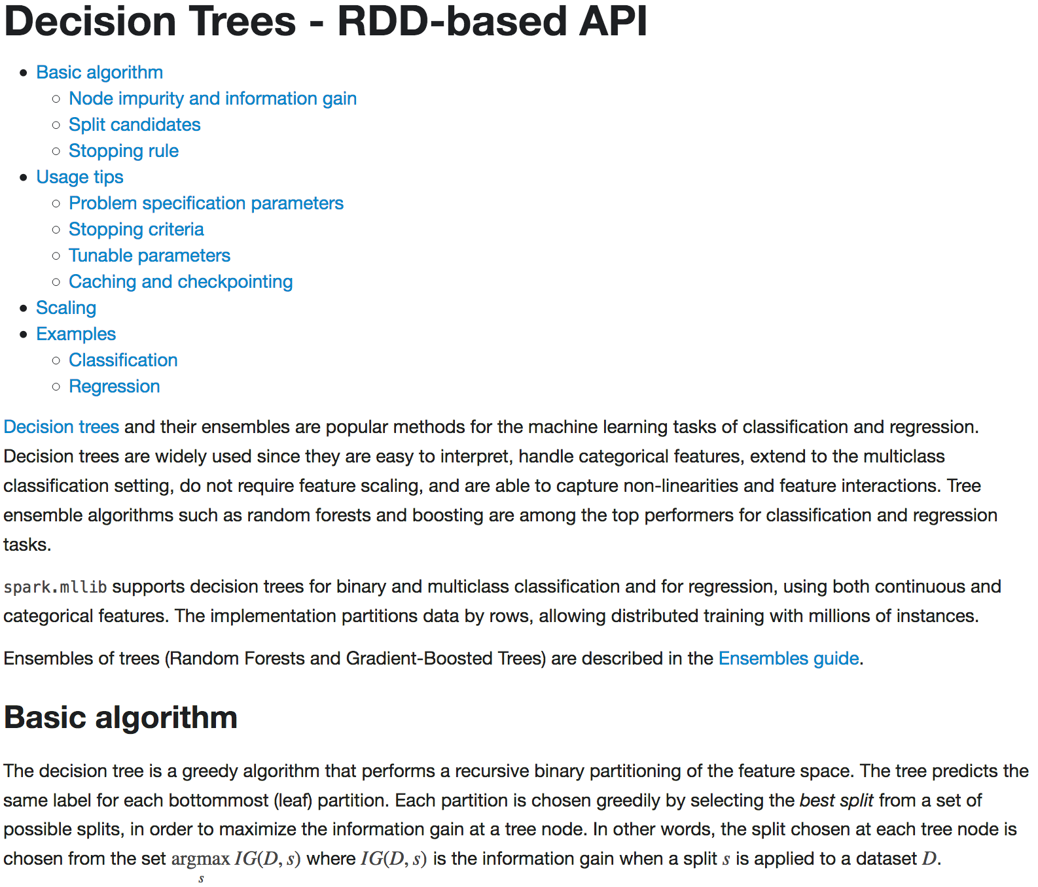
How would you know this
Url on Notes page
And this example
Notes:
Documentation page related to decision tree classifiers.
Reference Urls,
https://spark.apache.org/docs/latest/mllib-decision-tree.html#classification

Slide 67
End of Unit:
Notes:
End of Discussion Unit-

Slide 68
Additional Detail:
Notes:
The remaining content may be read “extra credit”, as time allows.

Slide 69
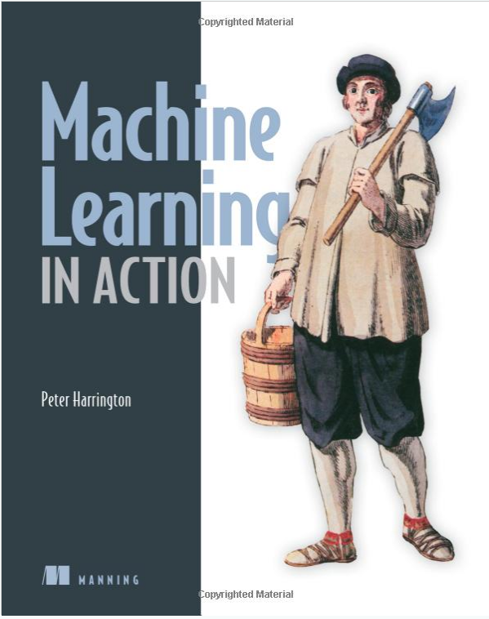
Machine Learning: A Must Read ?
Older, Amazon
Python
Most examples also coded by hand; great for deep understanding
Yes, Apriori
No, Decision Tree Classifier
Notes:
Reference Urls,
https://www.amazon.com/Machine-Learning-Action-Peter-Harrington/dp/1617290181

Slide 70
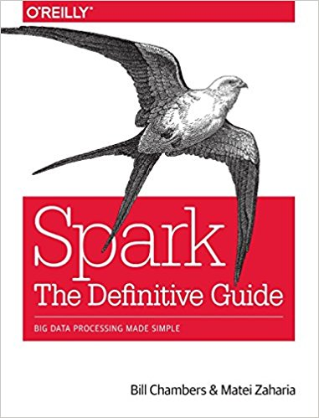
Machine Learning: A Must Read ?
Amazon
Python, Scala
Newer
Complete, if you already have some sense of the material
No, Apriori
No, Decision Tree Classifier
Yes, others
Yes, basics like pipelining
Notes:
Reference Urls,
https://www.amazon.com/Spark-Definitive-Guide-Processing-Simple/dp/1491912219

Slide 71


Apriori Algorithm: Source
Spark-ML overview-
Parallel compute engine, storage in DataStax
Based on simple math (algebra, some calculus, some set operands)
DataFrames (typed RDDs), and better parallelism to routines
Machine learning: an algorithm that provides better results given more data
Apriori algorithm-
Used for recommendation engines (customer who bought x also ..)
1994, Latin ‘from before’ ..
Rakesh Agrawal,
MIT/Purdue
Ramakrishnan Srikant,
UW-Madison,
Google Fellow
Notes:
Relative to the Apriori algorithm.

Slide 72
Apriori
You put this in your shopping cart, then ..
Notes:
No additional notes.

Slide 73
Apriori
And after you chose a washer in stock,
16 straight washers, no other options
Notes:
No additional notes.

